Slide 1
Occupational safety

Slide 2
1993. XCIII. Law on Occupational Safety
The employee can only work in a safe working condition, keeping the rules and instructions for work safety in accordance with occupational safety training. The employee is obliged to work with his colleagues and perform his work in such a way that it does not endanger his or her own health or bodily integrity. He is therefore particularly obliged
(a) to ascertain the safe condition of the work equipment provided to it, as it is intended and to be used in accordance with the instructions of the employer, to carry out the specified maintenance tasks;

Slide 3
1993. XCIII. Law on Occupational Safety
(b) to use the personal protective equipment as intended and to provide for the cleaning required of it;
(c) wear clothing which does not endanger health or physical integrity;
d) to maintain discipline, order and purity in the work area;
(e) acquire and apply the knowledge necessary for the safe performance of his work;
(f) to participate in a prescribed medical examination of a certain number of years;

Slide 4
1993. XCIII. Law on Occupational Safety
g) immediately inform the employer of the malfunctioning or malfunctioning of the hazard, or eliminate the malfunction or malfunction thereof, or ask the supervisor to do so; h) report an accident, injury, or nausea immediately. Employees may not arbitrarily disable, disassemble, or modify safety equipment. The employee is required to cooperate with the employer to comply with the official measures taken to maintain a healthy and safe working environment and to implement the employer's measures to eliminate the hazard.

Slide 5
1993. XCIII. Law on Occupational Safety
The employee is entitled to claim from his employer
(a) conditions for safe and safe work, the implementation of protective measures required by occupational safety rules for hazardous activities;
(b) providing the necessary knowledge for safe and safe work, and providing access to training;
(c) the provision of work equipment, work equipment and protective equipment, protective beverage and sanitary facilities and sanitary facilities necessary for work.

Slide 6
1993. XCIII. Law on Occupational Safety
Employees should not be penalized for acting in a way that does not endanger health and safety, or for reporting in good faith due to the employer's default. This protection also applies to workers in occupational safety and occupational health.

Slide 7
1993. XCIII. Law on Occupational Safety
An employee is entitled to refuse work if his or her life, health or physical integrity is directly and severely compromised. If you are threatening others directly and severely with the instructions of your employer, you must deny your performance.
In particular, the necessary safety equipment, the absence or absence of personal protective equipment is considered as a hazard as defined in the previous paragraph.

Slide 8
for material handling
General Material Handling Safety Precautions:
Without the aid of hand, shoulder or back, with the weight standards being met, only the amount of material that can be safely stored can be transported safely;

Slide 9
for material handling
Manual Material Handling Operations:
catching the load
lifting,
transport,
hang-up.

Slide 10
for material handling
The most important rules for lifting and moving loads:
1. Heavy loads should only be lifted with straight back, folded knees, and slow, even rise.
2. Before lifting heavy loads, the feet must be placed in the supporting position.
3. The load should always be gripped securely, ie gripped with the entire palm.

Slide 11
for material handling
Hand-held material handling tools are hand-operated, simple tools, devices and tools that facilitate material handling and increase productivity. Most of these devices also contribute to increasing material handling safety.
Manual transport equipment
handcart

Slide 12
Personal (personal) protective equipment
The requirements for safe and healthy work are primarily met by technical and organizational tools. Technology should be designed and working tools should be used to avoid the risk of accidents, and environmental hazards (air, noise, temperature, etc.) should not cause health damage. If technical protection cannot provide complete safety, we also use personal protective equipment. Personal protective equipment - where necessary - the condition of work; where this is not the case, the work cannot be started; work without protective equipment must be stopped. Providing workers with personal protective equipment is the responsibility of the employer and cannot be transferred to the employee. It has to be the kind and the amount of protection that provides adequate protection against workplace hazards. There is no time to wear out the protective gear.

Slide 13
Personal (personal) protective equipment
It can be used as long as it has adequate protection. However, the employee must use the personal protective equipment, protective equipment provided for its intended use and cleaning. The choice of personal protective equipment requires occupational safety expertise. The law provides information on the necessary protective equipment according to the different parts of the body based on the harm. It is the duty of the employer to choose the protective equipment assigned to the work in question on the basis of the harm. The employer and the list of related protective equipment are usually recorded by the employer in internal regulations. The internal regulations define the jobs in which protective equipment is to be used and specify the type of protective equipment required for the performance of the work task.

Slide 14
Personal (personal) protective equipment
Hearing protectors.
To a greater or lesser extent, we are touching the harmful effects of noise in almost every workplace. The noise-reducing effect of noise can be prevented, but at least mitigated by the conscious and regular use of personal protective equipment. Noise reduction devices in different frequency ranges are different, so you have to choose the protective equipment according to the noise level in the given work area. The ears cover the ears in a shell-like manner and prevent the noise from reaching the ear canal. The two cases have an adjustable strap for the ear. The attenuation value of the ears at medium frequency is 10 - 25 dB, for high frequency (high tones) it reaches 30 - 40 dB.

Slide 15
Personal (personal) protective equipment
Protective clothing:
Protective clothing protects the body against work-related harm.
Mechanical effects: puncture, cutting, abrasive, abrasive, abrasive contact caused by tools, materials, environment. Therefore, protective clothing is usually two-piece (jacket and trousers), dense weave, water and dirt repellent, buttoned, long sleeves, and pockets do not stop. Material is abrasion resistant, easy to clean and clean. Made in different colors and shapes.

Slide 16
Personal (personal) protective equipment
Hand protection.
Most of the occupational accidents are hand injuries. There is hardly any work in which there is no need to use the hand. Protective gloves selected according to the various types of harm will provide adequate protection against hand injuries. Protective gloves only serve the purpose if the shield of the hand does not hinder its movement, secure grip, has a long service life and is as comfortable as possible. It is therefore important to always choose the most suitable protective gloves for the job.

Slide 17
Personal (personal) protective equipment
Mechanical damage is usually a stinging, cutting, abrasive, abrasive effect that occurs during work. Heavy duty protective gloves are reinforced in the areas most exposed to wear.

Slide 18
Personal (personal) protective equipment
Foot protection.
They protect the workplace against stabbing, cutting materials, chips, falling objects, chemical impurities, heat, slipping. In the case of fatigue, it is not negligible - especially in the case of standing work - that the footwear should be comfortable, stable, sparing and sparing. Its sole, nose, and stem are shaped to protect against harmful effects.
In the area exposed to minor mechanical stress and chemical contamination, the shoe with attractive, semi-shoe design provides adequate protection

Slide 19
Personal (personal) protective equipment
For higher mechanical stress, falling objects, and risk of trapping, use footwear with anti-slip nose (steel or plastic scraper) with oil-resistant adhesive.

Slide 20
Office work with a computer
Minimum health and safety requirements for on-screen workplaces and workplaces in accordance with Art. (XI. 3.) EüM Decree
Display Device: A device for displaying numeric, letter, and graphic sequences on a screen, regardless of the display process used.
On-screen workplace: a set of work tools that can be connected to an on-screen device (keyboard, scanner, camera, other input device), other peripherals (pointing device, printer, plotter, disk unit, modem, etc.), possible accessories, human-machine connections defining software, file storage, work chair, desk or work surface, telephone, and direct work environment.

Slide 21
Office work with a computer
Eyewear for screen work: eyepiece lenses as required by the ophthalmologic examination and required for normal use of the lenses, including eyeglasses or contact lenses not used by the worker before work on the screen.
On-screen job: A job that requires the use of a on-screen display device for at least four hours of the employee's daily work, including work with monitor screening.

Slide 22
Office work with a computer
Minimum requirements and equipment for screen design
General provision
The display equipment shall be designed, commissioned and maintained in such a way that, when used as intended, it does not constitute a health risk or an accident hazard to workers.
Screen
The on-screen signals are well defined and light in shape, with the right size, with the right space between the signals and the lines.
The image on the screen should be stable, no flicker or other form of instability should occur.

Slide 23
Office work with a computer
The contrast between the brightness and the signals and the background should be easily adjustable by the user and easily adaptable to the environmental conditions.
The screen can be easily and freely swiveled according to the user's needs and tilted.
A separate monitor shelf or adjustable table should be provided.
The screen should be free of reflections and reflections that can cause the user inconvenience or difficulty in seeing.

Slide 24
Office work with a computer
Keyboard
The keyboard should be tiltable and stand out from the monitor so that the user can maintain a comfortable working position, without having to wear his arms and hands.
There should be enough space in front of the keyboard to support the hand and wrist of the computer operator.
The surface of the keyboard should be glossy to avoid light reflection.
The keys on the keys are easily distinguishable from each other and easy to read from the workplace.

Slide 25
Office work with a computer
Work table or work surface
The desk or work surface must have a non-reflective surface and size to provide a flexible layout of the monitor, keyboard, documents, and attachments.
The rack should be adjustable and can be locked in a comfortable position for the user.
work Office
The work chair should be stable and provide easy, free movement and comfortable posture for the user.
The height of the chair should be easily adjustable.
The back of the chair should be adjustable in height and tilted.
If required, a footrest or heel support or armrest must be provided

Slide 26
Industrial accident
Industrial accident
OPERATIONAL ACCIDENT PROTOCOL according to labor safety legislation is not covered by the LXXXIII. In accordance with Section 52 para. (1) of the Act no.
In addition to employers, you are required to record a working accident report:
the county health insurance fund and branch office
Hungarian State Treasury

Slide 27
work accident
An accident at work for which the worker was incapable of working for more than three working days and an occupational disease and an increased exposure case must be reported, examined and registered.
Accident at work: an accident that occurs during or in connection with the work of an employee, regardless of the place and time of the work and the extent of the employee's (injured) involvement. In the context of work, an accident occurs when the worker is involved in transport, material handling, material handling, cleaning, organized plant catering, occupational health services and other services provided by the employer, etc. when using it. It is not considered an accident (work accident) related to work that is the accident that occurs to the injured person from his / her apartment (place of work) to his / her workplace or from his / her workplace to his / her home (accommodation) during the journey, unless the accident has occurred with the employer's own or rented vehicle.

Slide 28
work accident
It is a serious job accident
the death of the injured person (a fatal accident at work, the accident that, within one year, the injured medical expert said he had lost his life in the context of the accident), the permanent harm to his / her or his / her newborn or his / her life;
has caused the loss or significant damage to a sensory, sensory, reproductive ability
According to medical opinion, life-threatening injury, health damage;
loss of a large part of two or more fingers of a thumb or hand, and more severe bone loss;

Slide 29
work accident
The employer must immediately investigate the incapacity for work accident and record the result of the investigation in a work accident report. The physician of the occupational health service should be informed of the initiation of the investigation. The doctor in charge of the basic occupational health service decides on the medical involvement in the investigation. In the event of a serious occupational accident, the physician providing the basic occupational health service must be involved in the investigation. The employer must immediately report the serious accident at the telephone, fax, e-mail or personally, by communicating the available data to the district office (hereinafter referred to as the "occupational safety authority") of the Capital and County Government Office competent at the place of the accident. the notification is immediately forwarded to the ministry headed by the minister responsible for employment policy. The circumstances of a work accident that does not result in incapacity for work must also be clarified.

Slide 30
Fire safety

Slide 31
Workers fire protection tasks
All employees are required to familiarize themselves with fire protection regulations, the contents of the Fire Safety Regulations, and to comply with them, and to prevent fires.
In order to prevent fires, appear in a workplace in a working condition, resting, free of alcohol and medicine.
Participate in training and examinations to complete your job.
Observe the Fire Safety Regulations during the work, and keep the smoking ban.
Inspect the tools, machines (especially electrical machines) before starting work in accordance with the operating instructions and use them as intended.
At work, keep order, cleanliness, and eliminate any circumstances that could cause fire.

Slide 32
Workers fire protection tasks
If you detect a fire or explosion hazard, you must stop it, report it immediately to your immediate work manager.
Use workstations, equipment, and tools at the workplace as required, if necessary.
From the danger zone, from the room, from the machines, the combustible material and waste created during the work is removed continuously, at least at the end of the shift.
When performing occasional fire and explosive activities, you must ask for a written permission to do so during your work and to comply with it in the course of your work.
The designated escape routes, doors, gateways must be kept in a permanent condition. Blocking is not yet temporary.

Slide 33
Workers fire protection tasks
If the facility detects a fire or a direct threat to the facility, people in the facility must be alerted and notified by telephone of the regional disaster management headquarters and direct manager.
The fire indicator is required to tell where the fire is (location, street, house number), what is burning, what is at risk (building, house, furniture) there is a danger to life, how large the fire, the name of the fire alarm and the telephone used for the notification number. The telephone number of the fire brigade 105.
In the event of a potential fire, all workers are required to participate in the extinguishing of the fire. Within this, the firefighter's head arriving at the site will be fully executed, preventing the spread of fire by closing the windows of the doors.

Slide 34
Workers fire protection tasks
Fire-fighting equipment, hydrants and equipment may only be used for their intended purpose.
Sand, shovels, buckets for fire-fighting purposes should not be temporarily used for any other purpose.
At the workplace, only the amount of material needed for continuous activity can be stored
The combustible waste generated during the activity must be removed continuously, but at least per shift or after completion of the activity.

Slide 35
Workers fire protection tasks
Occasionally, fire and explosive liquids should only be used outdoors or in a well-ventilated room where there is no source of ignition.
Do not use shoes, clothing or equipment in a fire hazard class A-B that causes a fire hazard.
It is forbidden to close the doors of rooms where people are in operation during operation!
During decommissioning the keys of the locked room shall be located so as to be accessible in case of fire. The location of the key must be indicated at the entrance of the room.
Occasionally flammable activities should only be performed with written permission.
Do not leave unattended fires and fired combustion units outdoors.

Slide 36
Workers fire protection tasks
Smoking Rules:
Do not place burning tobacco, matches, or other sources of ignition in a place where it could cause a fire or explosion.
Smoking is prohibited in the danger zone A-B-C, outdoors, indoors, and where there is a risk of fire or explosion.
The smoking ban should be marked with a table.
It is forbidden to introduce an ignition device into a room or building of fire hazard class “A-B” if there is no written permission to perform occasionally flammable activity.

Slide 37
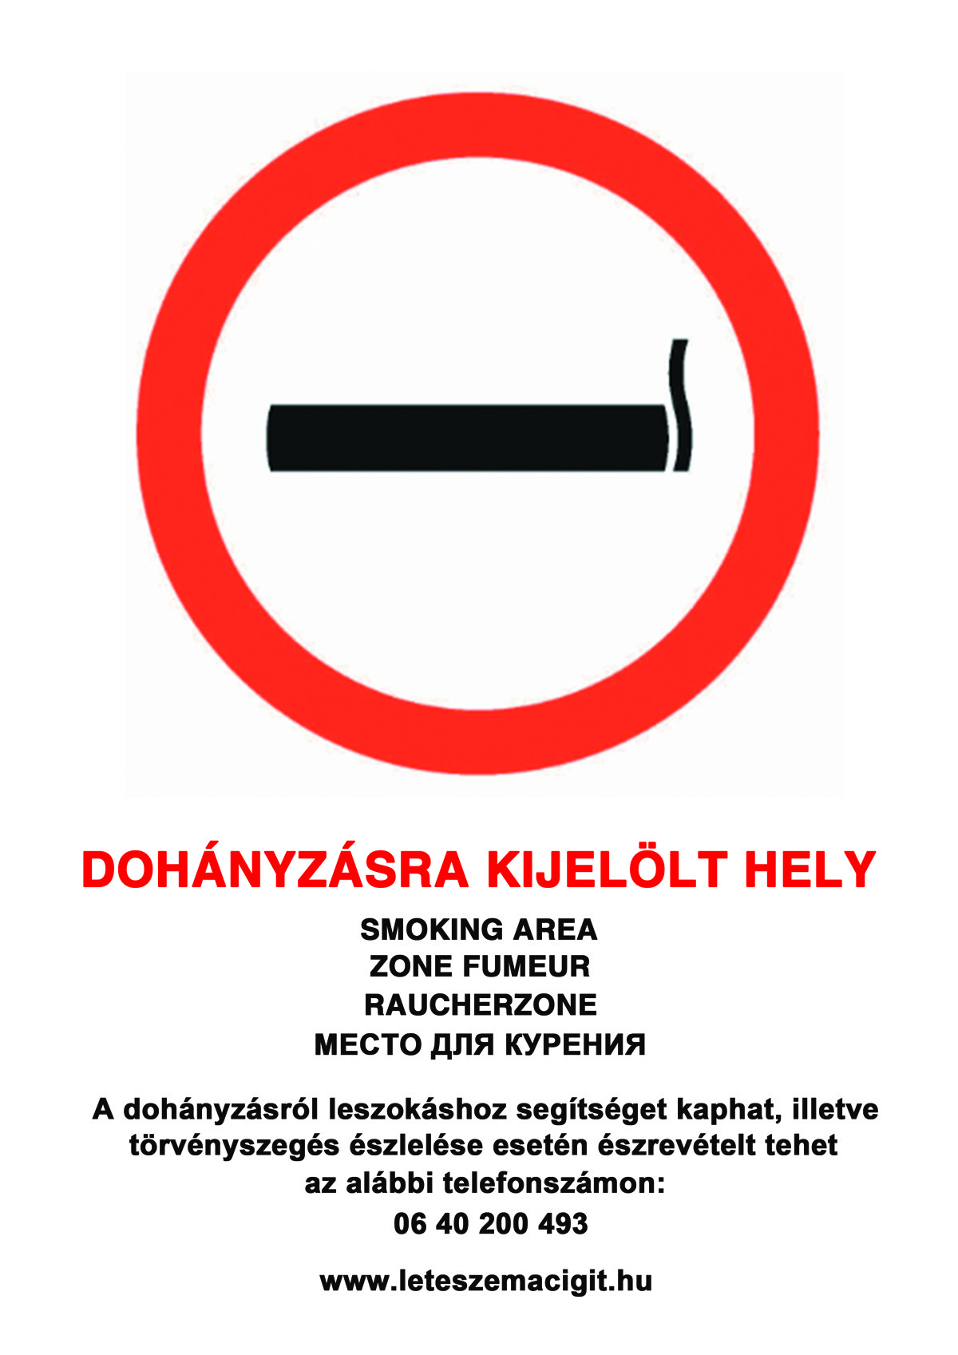
Workers fire protection tasks
At the workplace, you can only smoke in a designated smoking area to protect non-smokers. The contents of ashtrays must not be emptied into paper bags.

Slide 38
Fire-fighting
Fire-fighting
Everyone is required to participate in fire extinguishing and technical rescue without any compensation, and data are communicating years.
The fire brigade can only be a member of the fire brigade. Other persons may only take action at the fire site with the prior permission of the firefighting officer.
Individuals may be required to contribute to fire extinguishing, rescue work to the extent required by their age, health status and physical condition.
The firefighting manager may order that persons involved in the extinguishing of a fire may enter a private home or into a building or facility owned by legal entities.
Everyone is obliged to provide a means of communication for fire detection and assistance in the event of a fire, if necessary, to assist with his vehicle

Slide 39
Fire-fighting
Extinguishing of electric fires
In the case of extinguishing fires of electrical origin, it is advisable to first eliminate the electrical supply by considering that the discharge of the voltage does not eliminate the water supply and that the lighting in the area to be extinguished does not disappear.
Do not extinguish electrical equipment with water or wet foam.
Gaseous extinguishing is suitable for extinguishing fires of electrical origin. (Carbon Dioxide) When used in a confined space, however, there is a risk that persons in the space to be extinguished will be blocked from oxygen, causing suffocation.
Vacuum extinguishers are suitable for extinguishing electric fires.
Electrical appliances should not be approached more than 1.5 meters during fire extinguishing.

Slide 40
Fire safety misdemeanor
It commits a fire violation:
Any person who violates the regulations contained in fire protection regulations or fire regulations and the standards of mandatory fire protection standards
detects a fire or fire hazard, and does not mean this to the authority
deliberately misleads a fire alarm
your phone is not available for fire alarm
does not comply with the authority's call to personally contribute to the extinguishing of the fire, or to make its vehicle or fire-extinguishing means available for extinguishing the fire,
in the event of fire, does not execute the action of the firefighting officer, or does not provide the necessary information for the purpose of extinguishing the fire with a fine.

Slide 41
Use of fire extinguisher

Slide 42
Use of fire extinguisher

Slide 43
Use of fire extinguisher

Slide 44
Use of fire extinguisher

Slide 45
Use of fire extinguisher

Slide 46
Advice for extinguishing fire

Slide 47
Advice for extinguishing fire

Slide 48
Advice for extinguishing fire

Slide 49
Advice for extinguishing fire

Slide 50
Advice for extinguishing fire

